Slide 1









Using WS-Agreement for Risk Management in the Grid
Matthias Hovestadt
University of Paderborn, Germany
European Commission
6th Framework Programme
Contract IST- 031772

Slide 2
Outline
Risk on the Grid
Research Context
  User
  Broker
  Service Provider
Grid services based on SLAs and QoS
Proposed System
Scenarios
Challenges
Concluding Remarks

Slide 3
Risk? What Risk?
Risk
  Defined as the combination of the probability of an event and its consequences
Risk is negative …
  Avoid it using risk management
Risk is positive …
  Opportunities may be created as a result of risk taking
  Potential benefits when taking certain risk
Risk management
  Identification and treatment of risk

Slide 4
Why Risk Assessment and
Risk Management in Grids?
Grid technologies reached high level of development
Large-scale Grid deployment needs
  Commercial Grid providers and services
  Working demonstrators in different areas
  Standardisation efforts for access and interoperability
Early adopters underline core shortcomings
  Quality of Service ⇒ guaranteed resource usage over time
  Security, Trust, and Dependability
Service Level Agreements (SLAs) address shortcomings
  Definition of business relationship
  Forces development of QoS-aware middleware/OS

Slide 5
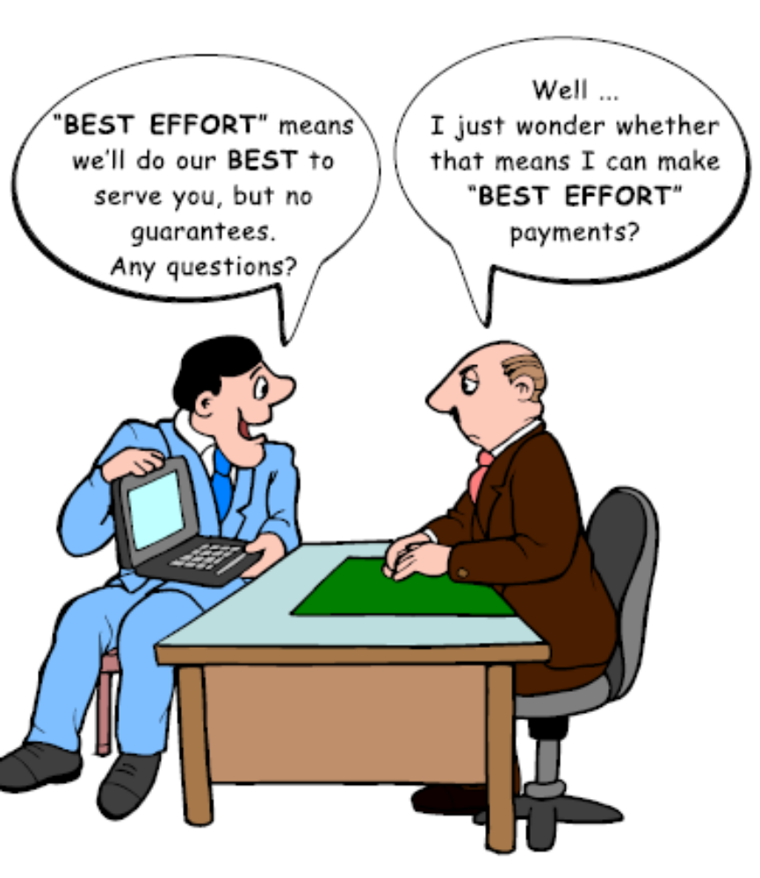
SLAs: Best Effort is not Good Enough …

Slide 6
SLAs: Best Effort is not Good Enough
Specified amount and quality of resources over certain time mandatory to reach desired performance
  Delegation of particular resource capabilities over a defined time interval from resource owner to requester
  SLA as explicit statement of expectations and obligations in a business relationship between service provider and customer
Name
ID or Description of SLA
Context
Contract Parties, Responsible Persons
Terms
R-Type: HW, OS, Compiler, Software Packages, …
R-Quantity: Number CPUs, main memory, …
R-Quality: CPU>2GHz, Network Bandwidth, …
Deadline: Date, Time,…
Policies: Demands on Security and Privacy, …
Price for Resource Consumption (fulfilled SLA)
Penalty Fee in case of SLA violation
Service Level Agreement
Service Level Agreement

Slide 7
Grid Providers and SLAs
SLAs needed, but providers are cautious about adoption
Why? ⇒Business case risk
SLA violation and penalties due failures, DoS attacks, overloading
Missing indicators ⇒ QoS level to be offered?
Enough resources for Grid jobs?
Fault tolerance available?
Actions to be initiated?
Bottleneck indicators for system planning
Acceptable price and penalty regarding current risk, effort?
What is the risk of accepting an SLA?

Slide 8
Grid Brokers, Users and SLAs
Reliability as selection criterion
QoS?
Trustable QoS level information?
Reliability with respect to utilisation?
QoS information service?
Decision-
support for job assignment?
Reliable provider for e.g. time-critical application?
Penalty high enough to cover potential delays?
What is the risk of assigning an SLA?

Slide 9
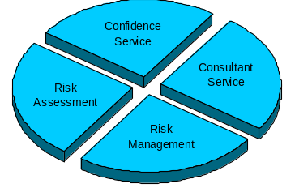
Grid Services based on SLAs and QoS
End user
Broker
Reliable and trustworthy
Grid provider?
Reliable services for workflow mapping?
Improve efficiency, reliability, and trust to attract Grid users?
Provider

Slide 10
Grid Services based on SLAs and QoS
Consultant service
  Information provider for risk assessment
  Monitoring service
  Analysis and data mining tools
  Problem identification, e.g. bottlenecks
  Recommendation for accepting/rejecting SLAs
Confidence service
  Quality of risk assessment
  Information on successful/violated SLAs

Slide 11
What Do We Want to Achieve?
Risk indicators as core part of SLA assignment and acceptance
Customised risk presentation for improved usability and trust
Decision/planning/management-support for QoS-aware Grids
Grid provider evaluation and competition
Notes:
Therefore, the main scientific and technological objectives of the AssessGrid project are to provide
Mechanisms for risk identification, risk assessment, risk treatment, and risk monitoring on all Grid layers as decisive components for negotiation and enforcement of SLAs as well as for definition of business models; results in new decision processes on each Grid layer
Risk-based support for decision making in quality and capacity planning leading to higher productivity and cost-effective usage of virtualised resources; benefits can be evaluated by comparing system workload and profit before and after using AssessGrid developments
Risk measures as parameters for self-organising fault-tolerant systems; statistics/simulation of violations with and without preparatory FT mechanisms can show the benefits of acting precautionary
Improved transparency, usability, and trustiness by customised presentation of confidence and risk information to end-users, brokers, and providers; can be measured be the increase of Grid utilization, commercial establishment, but this can only be evaluated for Grids using AssessGrid developments
Aggregated quality and reliability information of performance as fundament for provider evaluation and competition; will be realized by the confidence service
A consistent realisation based on existing Grid developments and standards as well as the evaluation of risk management methods in real-world environments
The achievement of these objectives will be measurable and verifiable by implemented Grid software which demonstrates the functionalities of added components. Each objective will be achieved step by step. Accordingly, each workpackage enhances Grid functionalities in respect to the main objectives until they will be achieved to their full extend at the end of the project.

Slide 12
Proposed System
Generic, customisable, and interoperable open-source software for risk assessment, risk management, and decision-support in Grids
Provider/ Broker/ End-user perspective
Integration in Grid service
Risk
assessment
and management
Integration in Grid middleware
Broker service
Monitoring
Planning-based RMS
Consultant /Confidence service
Ad-hoc risk management
Integration in Grid fabric
Notes:
It will develop and integrate methods for risk assessment and management in all Grid layers. The corner stones are risk management scenarios reflecting the perspective of Grid end-users, brokers, and providers. The results will support all Grid actors by increasing the transparency, reliability, and trustiness, as well as providing an objective fundament for planning and management of Grid activities.

Slide 13
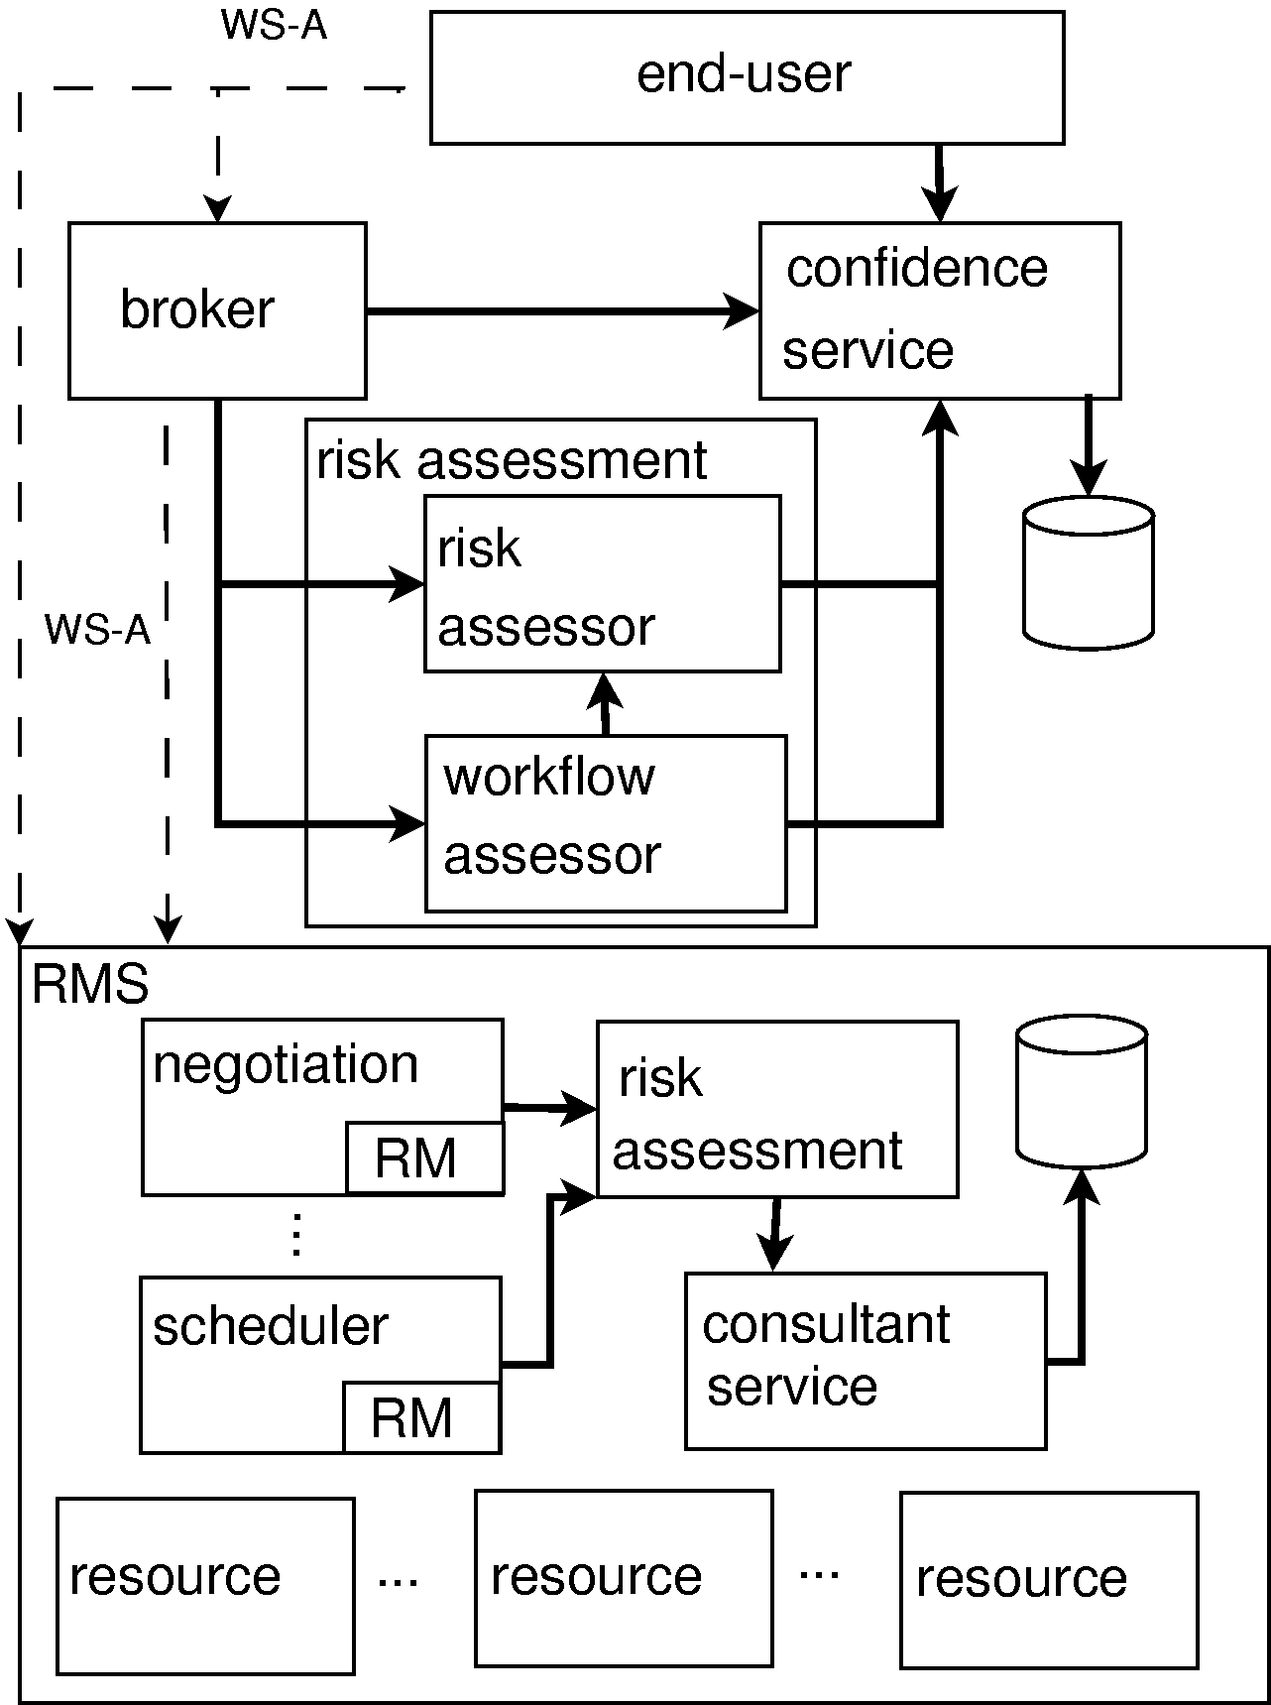
Proposed Architecture
WS-Agreement specification
  promising approach to provisioning services in an interoperable manner
Negotiation features make it an appropriate framework to use in AssessGrid:
  User – Broker
  User – Provider
  Broker – Provider
Risk
  enters the Grid as negotiable parameter
  can be incorporated into SLAs as additional attribute.
Notes:
It will develop and integrate methods for risk assessment and management in all Grid layers. The corner stones are risk management scenarios reflecting the perspective of Grid end-users, brokers, and providers. The results will support all Grid actors by increasing the transparency, reliability, and trustiness, as well as providing an objective fundament for planning and management of Grid activities.

Slide 14
End-User
End-user describes prerequisites for job execution
  hardware architecture, operating system, memory, libraries, etc
User interface modifies the broker’s/provider’s SLA template based on this input and sends it to the Grid broker or resource provider in order to gather SLA offers
  Communication through WS-Agreement protocol
Offers are returned to the end-user who can select the different SLAs and read their content, e.g. fee, risk of failure, penalty in case of failure, options to reduce the computed risk, and the operation’s costs, etc
WS-Agreement used to represent SLA conditions
Extending WS-Agreement in the risk assessment and management domain
  necessitates the definition of risk specific agreement terms
  what needs to be defined is a term language to describe
    job requirements and attributes negotiated by users/brokers and resource providers to reach agreements
    risk.

Slide 15
Broker
Broker negotiates with the provider on behalf of the end-user
  responsible for enabling risk-aware negotiation for resource usage and application execution
  deployed as a Grid service
  WS-Agreement used to establish SLAs.
Envisage a commitment level for the term risk
  can take on a value to indicate that
    both parties (user/broker or broker/resource provider) have committed to this value of the term
    will operate in an agreement based on it.

Slide 16
Provider
Grid fabric
  the provider manages its resources, reservation and allocation of corresponding resources
  estimate of the risk of failure of an SLA
  consultant service supports the provider’s risk assessment methods with statistical information
Communication between the components through the use of WS-Agreement
Resource provider can advertise its capabilities as part of its dynamic interface using dynamic service data
Job submission port types may need to be defined by extending the domain-independent port types exposed in the WS-Agreement specification to support risk management.

Slide 17
Acknowledgements
AssessGrid Project Partners:
Paderborn Center for Parallel Computing, University of Paderborn, Germany
CETIC, Belgium
Abo Akademi University, Finland
ATOS Origin, Spain
Wincor Nixdorf, Germany
School of Computing, University of Leeds, UK
Information: www.assessgrid.eu

